Slide 1
Legal dimensions of the blue economy
25 November 2019
Draft Briefing Note prepared by IIED
Presentation to RP1 group
25 November 2019

Slide 2
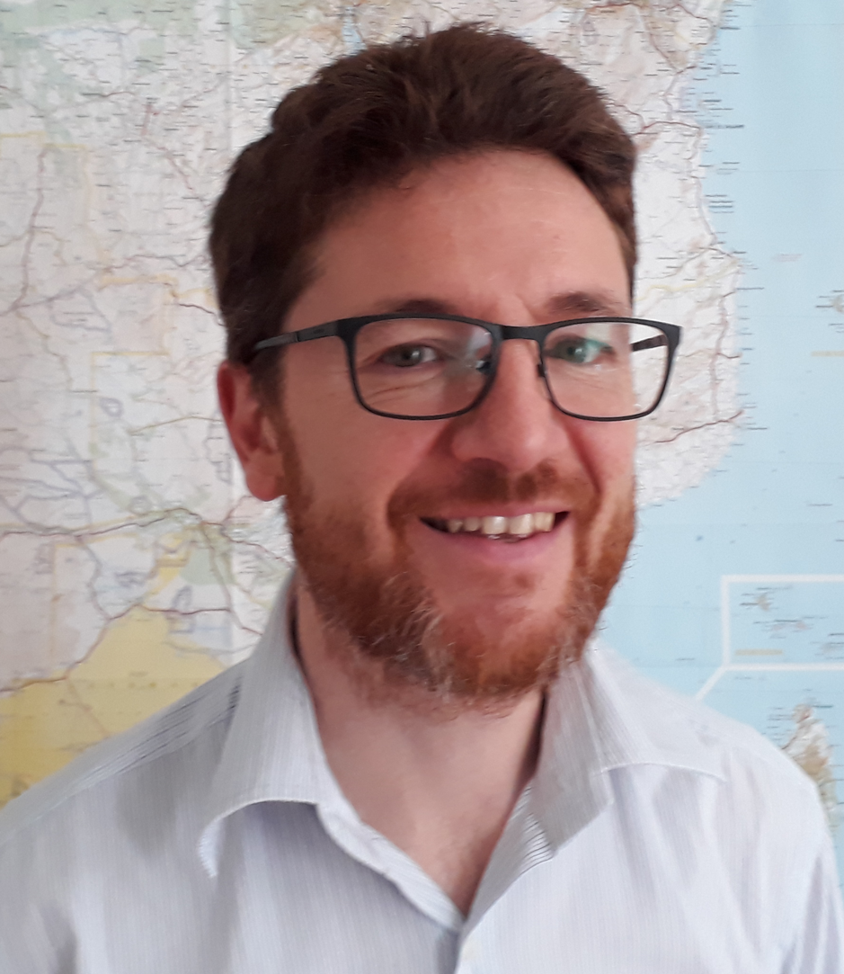
One Ocean Hub IIED Team
Lorenzo Cotula Thierry Berger
Notes:
My name is Thierry Berger and this is my colleague Lorenzo Cotula.

Slide 3
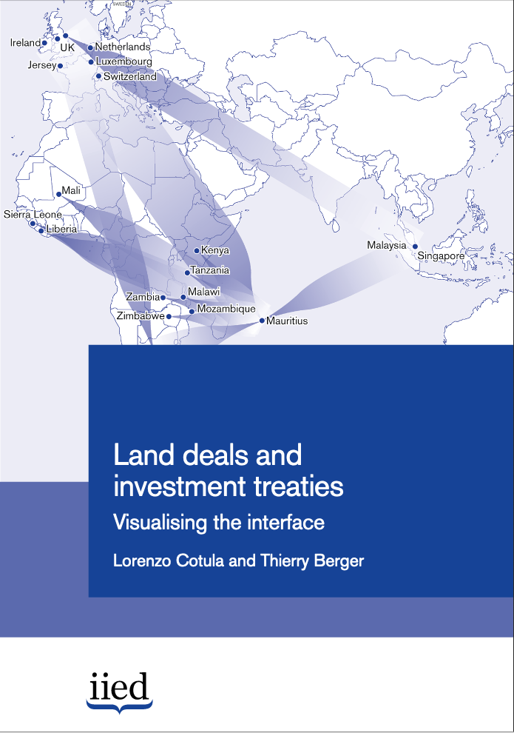
About IIED
A policy and action research organisation working to promote sustainable development
Research & action on the law of the global economy, growing work on ocean governance including in UN context
Partner networks, communicate evidence & translate it into policy
Notes:
I am an Associate at
International Institute for Environment and Development – IIED
Lorenzo Cotula is Principal Researcher at IIED
Briefly IIED is a policy and action research organisation working to promote sustainable development.
IIED undertakes research & action on the law of the global economy. We have a growing work on ocean governance including in the UN context.
IIED works with networks of partners, communicates evidence & translates it into policy.

Slide 4
Overview
Scoping study on legal dimensions of the blue economy, leading to a short publication in the form of an IIED Briefing Note (2,500 words)
Limited space: focus on international investment law (IIL), consider deep seabed mining and fisheries. One case study from Ghana.
Will identify areas for further exploration / follow-on work, and links to wider range of OOH activities
Notes:
We’ve been preparing a scoping study on the on legal dimensions of the blue economy which will be leading to a short publication in the form of an IIED Briefing Note (2,500 words).
Due to limited space: focus on international investment law (IIL) and consider deep seabed mining and fisheries. There will be one case study from Ghana.
We will identify areas for further exploration / follow-on work, and links to wider range of OOH activities

Slide 5
Blue economy and IIL
Blue economy: national laws, international law (UNCLOS), contracts / licences
IIL – the international law norms that govern the admission and treatment of foreign investment
IIL consisting of a global network of international investment treaties (IITs) that typically allow investors to bring claims against the host state directly before an international arbitral tribunal
Different objectives: protection of the marine environment (& common heritage of mankind for activities in the Area) v protecting commercial interests
Notes:
Blue economy is made up of national laws, international law (United Nations Convention on the Law of the Sea), contracts / licences, e.g. joint ventures for large scale fisheries or contracts for the exploration and exploitation of minerals on the deep seabed.
International Investment Law (IIL) can be defined as the international law norms that govern the admission and treatment of foreign investment.
IIL consists of a global network of international investment treaties (IITs) or broader trade agreements that comprise investment chapters. Instead of relying on local remedies, IITs typically include legal protections for investors in the event of adverse conduct by the state and IITs typically allow investors to bring claims against the host state (that’s the state where the investment is made) directly before an international arbitral tribunal which can make binding decisions called ‘awards’ which can be easily recognized and enforced across the world. This mechanism is often called investor state dispute settlement (ISDS). Some arbitral tribunals have for instance held that IITs protect the legitimate expectations an investor had at the time of the investment. State action that violates the provisions of IITs by, e.g. frustrating an investor’s expectations, could expose that state to significant arbitration claims, having to pay large amounts of damages and legal costs. A state might for instance have - sometimes inadvertently - created such expectations via ‘promises’ made by its investment promotion agency to attract investors or by granting a permit to explore for oil and gas in a country’s waters.
The Law of Sea regime and IIL have different objectives: protection of the marine environment (& common heritage of mankind for activities in the Area beyond national jurisdiction (the Area)) whereas IIL is about protecting commercial interests.

Slide 6
Hopes but major concerns
Promises of blue growth but concerns of ‘ocean resource grabbing’. Impacts on the environment, human rights and the livelihoods of coastal communities
IIL increasingly relevant to blue economy – several cases relating to deep seabed mining fisheries, fisheries, oil and gas, tourism sectors etc.
IIL raises several concerns such as ‘regulatory chill’ affecting host state policies, planning and law-making in relation to natural resource development
Notes:
There are promises of ‘blue growth’ and activities such as deep seabed mining are becoming crucial to some governments and companies operating in the green technologies sector - but there are also concerns of ‘ocean resource grabbing’. Blue economy activities could have impacts on the environment, human rights and the livelihoods of coastal communities.
IIL increasingly relevant to the blue economy – several cases relating to deep seabed mining, fisheries, oil and gas, tourism sectors etc. Just last week an award was published in the case Oded Besserglik v. Republic of Mozambique (ICSID Case No. ARB(AF)/14/2) concerning the alleged expropriation of the investor’s interests in a prawn fishing venture. A recent case Odyssey Marine Exploration, Inc on Their Own Behalf and on Behalf of Exploraciones Oceanicas S. de R.L. de C.V v. United Mexican States, Notice of Arbitration (5 April 2019), which is the first known ISDS dispute relating to deep seabed mining in a country’s exclusive economic zone.
IIL is meant to promote foreign investment but the evidence that it actually achieves this on this is mixed. IITs raise several concerns such as ‘regulatory chill’: the prospect of facing arbitration claims and having to pay large amounts of damages and significant legal costs could result in states refraining from taking action for fear of violating treaty obligations. This could be affecting host state policies, planning and law-making in relation to natural resource development. Most IITs do not include obligations on investors to comply with human rights and further social and environmental benefits such as the sustainable development goals. As a result of those concerns there is a growing international debate on reforming IITs including ISDS and several initiatives are ongoing either by individual countries or on a multilateral basis.

Slide 7
Application of IIL to blue economy activities
Crucial question: to what extent can IIL apply to blue economy activities?
UNCLOS regime operates through diverse legal regimes of decreasing state control as distance from the coast increases v IITs refer to “territory”
Notes:
In the briefing note we mainly focus on one crucial question: to what extent can IIL apply to blue economy activities?
IITs refer to “territory” and an IIT either applies or it does not whereas UNCLOS does not have such a clear cut definition.
The UNCLOS regime operates through diverse legal regimes of decreasing state control as distance from the coast increases – that’s broadly the territorial waters, the exclusive economic zone, the continental shelf, and the area beyond national jurisdiction/ the high seas.

Slide 8
IITs: definitions of ‘territory’ and ‘investment’
IITs with a definition of ‘territory’ that includes territorial waters, EEZ and CS
IITs with no definition of ‘territory’
Usually broad definitions of ‘investment’
Notes:
IITs with a definition of ‘territory’ that specifically refer to territorial waters, EEZ and CS – obviously they apply to those areas.
The more interesting question relates to IITs with no definition of ‘territory’. Under UNCLOS coastal states have sovereignty or sovereign rights over their territorial waters, EEZ and CS and IITs would arguably apply to those areas but there does not seem to be any case law on this.
IITs usually include a definition of investment and blue economy activities need to fall within that definition. However the definitions are usually broad.
The definitions of investment also have other requirements e.g. sometimes they provide that they will only protect investments made in accordance with the laws of the host state.

Slide 9
Chinese trawlers in Ghana
Saiko fishing by ‘foreign’ industrial trawlers in Ghanaian waters
Majority of industrial trawlers reportedly linked to Chinese companies
IIT between China and Ghana: no definition of territory
Illegal activities?
Notes:
We propose to refer to case study relating to a form of illegal fishing in Ghana called ’Saiko’ by Chinese trawlers. Majority of industrial trawlers in Ghana are reportedly linked to Chinese companies that would acquire a license to fish in Ghanaian waters thanks to the use of ‘front’ companies based in Ghana. It has been claimed that this practice is against Ghanaian law.
Local artisanal fishers and NGOs have called for the government to put an end to this practice. What if the government cancels the licences?
There is an IIT between China and Ghana but it has no definition of territory. However as discussed, activities in Ghana’s waters would probably falls within the scope of the IIT’s territory.
There is also the question of the definition of investment. Chinese shareholding in the companies would probably fall within the definition of investment. However, the investment needs to be made in accordance with the laws of Ghana. Which could mean that the investment might not in fact be protected by the IIT.

Slide 10
Areas Beyond National Jurisdiction (ABNJ)
In the high seas and the Area, IITs would not a priori apply since states may not exercise any type of sovereign rights over maritime areas BNJ
State actions as members of the ISA?
Notes:
In the high seas and the Area, IITs would not a priori apply since states may not exercise any type of sovereign rights over maritime areas BNJ
That would concern fishing in the high seas or the exploration and exploitation for minerals on the deep seabed beyond the control of national jurisdiction.
But there may be exceptions if state actions as members of the International Seabed Authority have impacted some investments in the ABNJ. That’s hypothetical at this stage.

Slide 11
Activities in the Area
Investor to seek sponsorship from home state and enter into contract with ISA to explore resources in the Area
ISA developing regulations for deep seabed mining.
Investors bringing claims against the ISA before the Seabed Disputes Chamber of ITLOS under UNCLOS
Notes:
For the exploration and exploitation of resources in the Area an investor has to get sponsorship from its home State (UNCLOS, art 153(2)(b)); then that investor will need to apply to the International Seabed Authority to enter into a mining contract with the ISA (art 153(3)). The investor and the sponsoring state will enter into a contract governed by national law and the ISA ‘Mining Code’. By way of example, Fiji adopted the International Seabed Mineral Management Decree (No. 21 OF 2013) (the Fiji Decree) which describes the procedure relating to Fiji companies. Often foreign investors incorporate a local subsidiary in order to apply for sponsorship. They could do so in Fiji fir instance.
The ISA is developing regulations for deep seabed mining. Those regulations once adopted will include all sorts of obligations on investors.
In due course, investors may be able to bring claims against the ISA before the Seabed Disputes Chamber of the International Tribunal for the Law of the Sea (ITLOS) under UNCLOS. Currently no cases since exploitation has not started. Four specific grounds under UNCLOS including disputes regarding the interpretation of a contract between the ISA and an investor. The Deep Seabed Chamber could become very busy at some stage!
[a Fiji national may apply for a sponsorship from the Fiji International Seabed Authority with a view to getting a Sponsorship Certificate (section 24) and will need to comply with the Fiji Decree and the rules of the ISA (section 32). A Sponsored party may [then?] submit an application to the ISA for a contract for exploration or exploitation in the Area under Fiji’s sponsorship (section 30). The Fiji government may also enter into written agreements with the Sponsored party after the Sponsorship Certificate has been granted, to establish additional terms and conditions as to the sponsorship arrangement (section 31).]
ISA: the body responsible for organising and controlling activities in the Area, the International Seabed Authority (ISA, UNCLOS art. 157.1)

Slide 12
Further research?
Other sectors (e.g. tourism)
Impact of blue economy developments on human rights and livelihoods of coastal communities
Potential for IIL to support inclusive and sustainable blue economy investments against negative impacts from government
Notes:
Look at other sectors – tourism for instance.
There are already relevant cases dealing with investment in coastal areas re tourism resorts or protected areas. They refer to international environmental law instruments such as the Convention on Biological Diversity and the Ramsar Convention.
David Aven et al v Republic of Costa Rica, Award, ICSID Case No UNCT/15/3 (Award dated 18 September 2018) which concerns a tourism project.
Permanent Court of Arbitration, Peter Allard v Barbados (Award on Jurisdiction dated 13 June 2014 and Final Award dated 27 June 2016) relating to the acquisition of land in coastal areas to build ecotourism ventures
We could also look at the impact of blue economy developments on human rights and livelihoods of coastal communities.
Potential for IIL to support inclusive and sustainable blue economy investments against negative impacts from governments.

Slide 13
Thank you
Lorenzo Cotula: lorenzo.cotula@iied.org
Thierry Berger:
thierry.berger@iied.org

