Slide 1
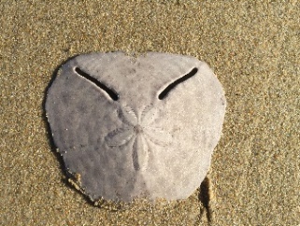
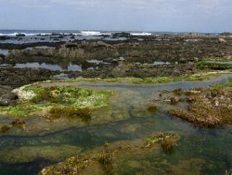
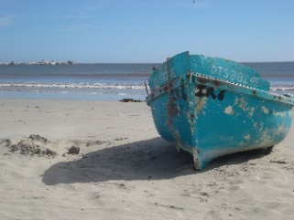
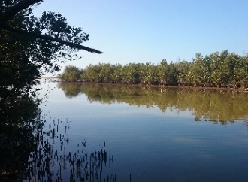
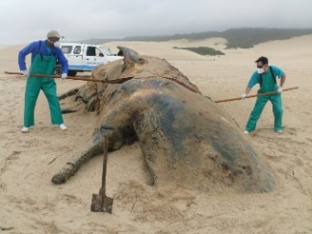
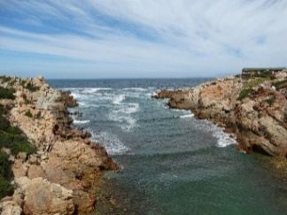
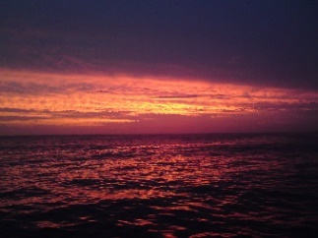
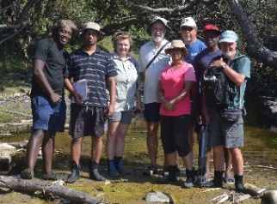
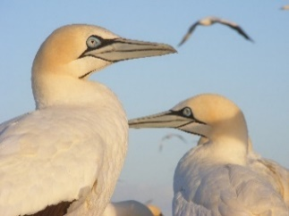
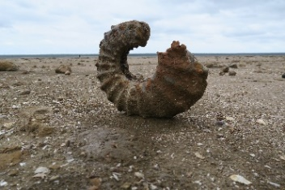
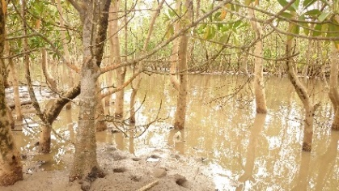
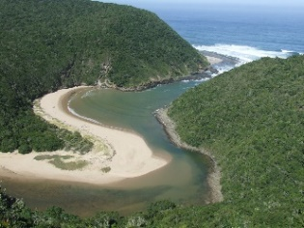
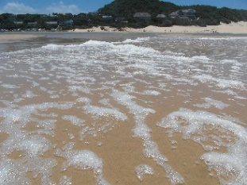
Programme: Institute for Coastal and Marine Research Symposium
20 April 2017  08:30 – 16:00  NMMU South Campus Council Chamber
The CMR is a research institute of the Nelson Mandela Metropolitan University conducting cutting edge research, building capacity and advancing our understanding of the coastal and marine environment to serve the needs of South Africa, the continent and beyond in a sustainable manner.
The objective of the symposium is to showcase the impact of research across disciplines and faculties, and identify opportunities for collaboration within three research themes: Living Resources and Food Security, Biodiversity and Conservation, and Global Change.
Presenter | Presentation Title | E-mail Address
Prof Janine Adams CMR Director | Impact of Coastal and Marine Research at NMMU | Janine.Adams@nmmu.ac.za
Dr Gavin Rishworth Post-Doctoral Fellow - SARChI: Shallow Water Ecosystems | Functional drivers of living stromatolite persistence along the Eastern Cape coastline | gavin.rishworth@gmail.com
Dr Jackie Raw Post-Doctoral Fellow - Botany | Measuring the response of coastal habitats to sea level rise | jackie.raw33@gmai.com
Dr Phumelele Gama HOD: Botany | Vulnerability of coastal wetlands in Nelson Mandela Bay Metro | Phumelele.Gama@nmmu.ac.za
Dr Shaun Deyzel SAEON | Considerations for multi-disciplinary approaches to understanding Global Change in Algoa Bay | shaun@saeon.ac.za
Dr Paul-Pierre Steyn Botany | Abalone ranching project – a multi-disciplinary approach | Paul.Steyn@nmmu.ac.za
Mrs Bernadette Snow CMR Deputy Director, Development Studies | Peoples knowledge, value and future outlook on marine socio-ecological systems | Bernadette.Snow@nmmu.ac.za
Prof Mike Roberts SARChI: Oceanography and Food Security | A new research programme: Sustainable Oceans, Livelihoods and Food Security through Increased Capacity in Ecosystem Research in the Western Indian Ocean (SOLSTICE) | Mike.Roberts@nmmu.ac.za
Prof Lyn Snodgrass Political and Conflict Studies | Blue Economy discourses: Are we speaking the same language? | Lyn.Snodgrass@nmmu.ac.za

Slide 2
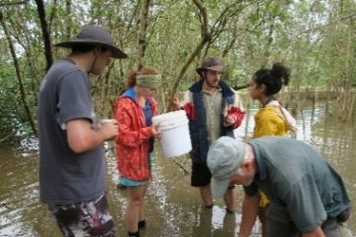
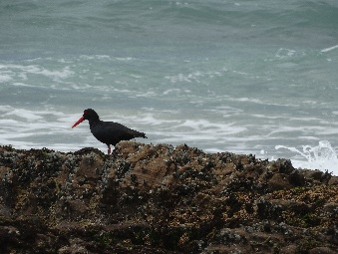
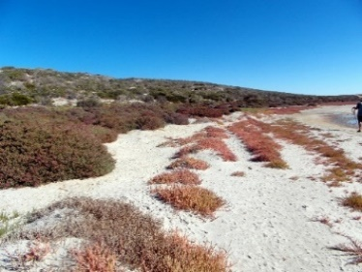
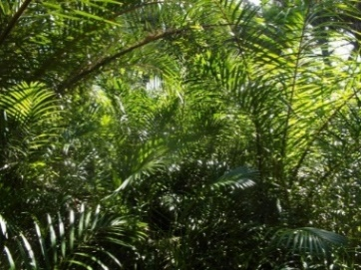
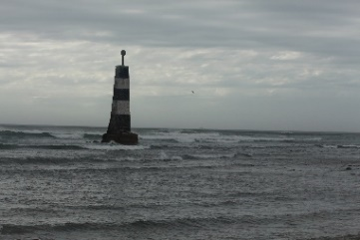
Presenter | Presentation Title | E-mail Address
Prof Patrick Vrancken SARChI: Law of the Sea | The decolonisation of the law of the sea | Patrick.Vrancken@nmmu.ac.za
Prof Amanda Lombard SARChI: Marine Spatial Planning (George) | Making our Marine Spatial Planning research matter | mandylombard2@gmail.com Mandy.Lombard@nmmu.ac.za
Mr Yusuf Adam CEO Management | Pooling SA’s knowledge areas for starting up aquaculture in the officially designated Aquaculture Zones | Yusuf.Adam@nmmu.ac.za
Prof Christo Fabricius Sustainability Research Unit (George) | The crow's nest of risk, vulnerability, resilience and adaptation in coastlines: Insights from the interface | Christo.Fabricius@nmmu.ac.za
Dr Alastair Potts Centre for Coastal Paleoscience, Botany | The relevance of paleoscience along the southern Cape coast | potts.a@gmail;.com Alastair.Potts@nmmu.ac.za
Ms Sinegugu Mbense PhD Student – Botany | Ecosystem services of coastal habitats and responses to climate change | s210235438@live.nmmu.ac.za
Prof Janet Cherry Development Studies | Global Change, Climate Change: Action Research on Climate Change and Development Alternatives: The Transition Township Project | Janet.Cherry@nmmu.ac.za
Ms Rachael Chasakara MPhil Student - SARChI: Law of the Sea & Marine Spatial Planning | Legal aspects of Marine Spatial Planning in South Africa | s212441590@live.nmmu.ac.za
Mr Nathi Dwayi Honours Student - SARChI: Law of the Sea | The extent of jurisdiction South African organs of state have at sea | s212362135@live.nmmu.ac.za Nathi.Dwayi@nmmu.ac.za
Ms Barbara Kritzinger Sociology and Anthropology | Examining symbolic representations of rivers and seas in the narratives of some Eastern Cape coastal peoples | Barbara.Kritzinger@nmmu.ac.za
Dr Pierre Pistorius Marine Apex Predator Research Unit, Zoology | Research highlights of the Marine Apex Predator Research Unit | Pierre.Pistorius@nmmu.ac.za
Prof Renzo Perissinotto SARChI: Shallow Water Ecosystems | Shallow Water Ecosystems Research: Focus Areas | Renzo.Perissinotto@nmmu.ac.za
Prof Nadine Strydom Zoology | Current advances in early stage fish research at NMMU | Nadine.Strydom@nmmu.ac.za
Mr Yanasivan Kisten PhD Student - SARChI: Shallow Water Ecosystems | Modelling the occurrence of marine estuarine-dependent fish in South African estuaries | yanasivan@gmail.com

