Slide 1
The challenges of combining motherhood and research during the coronavirus pandemic, and the resultant spillover on gender equality
Dr Nikki James

Slide 2
I’m a senior scientist at the South African Institute for Aquatic Biodiversity
Focus on coastal and estuarine fish ecology, particularly the relationship between fish and their habitat as well as climate change
Started out in Durban, did my masters degree at the Oceanographic Research Institute in the early 2000’s
Moved to the Eastern Cape in 2007

Slide 3
I started at SAIAB in 2009 and had my first child in 2011, I now have two kids Kelsi aged 6 and Cara who is 9
Having children definitely changes the way you operate as a scientist in a job which tends to be modelled (world-wide) on male scientists who are often away in the field, or at conferences and meetings and then in the evenings spend their time writing papers, while their wives bear the brunt of child rearing

Slide 4
Within this system having kids is an adjustment
You think you will be fine to go on long field trips and oversees conferences but it’s not that easy – I can remember going away for a two night trip and having my three year old sobbing inconsolably as I tried to leave (late for a flight) because you are now the center of someone else’s world

Slide 5
Luckily as a scientist we have flexibility in the work we take on and the projects we apply for
I have tried to work locally as much as possible and since moving to PE this has been easier with almost all my fieldwork now based in Algoa Bay
I have also tried to get as much done as I can in the office and then spend time in the evenings and weekends with my family

Slide 6
COVID has made combining parenthood and science that much harder, especially with schools being closed.
My kids nanny is a diabetic, so I have not had help with childcare or housework for months
In a given day, I try to sit and concentrate (which is nearly impossible with constant interruptions), get through home schooling with both kids, they are also too young to do this work themselves and need to use my and my husbands computers, spend time playing with my kids, housework etc..
I can work when my kids are glued to a screen (but then I feel bad because I’ve always tried to avoid too much screen time for my kids)
I am lucky in that my bosses are understanding of the challenges of working from home and parenting
Found that I can go through students chapters but not write up my own papers
I am also lucky in that I am at the stage in my career where I have a pipeline of students who are publishing, so COVID is not having as big an impact on my productivity as it is having on early career scientists

Slide 7
What fellow mom scientists have said when I asked them if working from home during COVID has impacted their science:
Dr Lara Atkinson SAEON scientist, mom to 6 year old
“Funny how the children always seem to shout Mommy so much more than Daddy..... wonder why that is? But yes productivity levels are definitely strained, and I have even managed to get my nanny back most days.... But we just got to keep doing the best we can and try not to be too hard on ourselves.... truthfully I really would choose to have secure, stable and well-balanced children rather than a few more papers to my name.... I think I accepted that fact long ago.... but does still make it hard to swallow when the men just seem so much more able to "not hear/notice" the chaos going on around them and plough on ahead focused on furthering their careers”

Slide 8
Dr Tarryn Murray SAIAB. Scientist and mother to Becky (6 months) and Mikey (2 years old)
“I have found it to be an extremely frustrating time. There are so many feelings that it’s actually quite difficult to put into words. I want to work. I enjoy working, I want to further develop my skills as a scientist, I want to work on papers to increase my number of outputs – all things important as an early career scientist. BUT when you have two small children under 3 and limited help (my mom-in-law), this is just entirely unachievable. It might be better if I had a nanny though. I’ve found I have to work at night which I feel is also dampening my relationship with Dale. We’re hardly communicating as is and are two ships passing in the night at the moment – it’s just kids and work and and and. I feel like we hardly ever get to just sit and chat and when we do it’s a whisper because the baby is sleeping… I also get so incredibly mad with him sometimes because he can just up and leave and say he’s going to work and it’s completely fine. I could never even dream of doing that and the injustice of me being expected to just stay here and look after the kids is infuriating. So, in short, for me, yes. Yes it is and has. I know I should be appreciating the time I have with my kids, I mean when else will this happen again (cue the mom guilt), but sometimes, I just want to do something for me, and that is sometimes work.”

Slide 9
Dr Amber Childs, senior lecturer Rhodes University mom to Riley (3 years old) and Josh (5 years old)
I am in the same department as my husband, who is a Prof in our department. We have had considerable help from my Mom, yet we are still struggling to balance work and kids. I feel permanently guilty for telling the kids that I always have to work (on the computer, Zoom meetings or just hanging the washing). Younger kids seem so much more demanding than older kids and although we share the parent and work load, calling for Mom definitely seems to be the first port of call during the day (and every night and early morning). I suppose it’s just natural, and to be honest, I wouldn’t want it any other way. One thing I can say is that the divide between scientists with kids (especially younger kids) and those without kids during Covid is massive. I am fully aware that Covid has brought anxiety, uncertainty and hence lack of productivity to many without children, but for those that can cope, I think Covid has provided an incredible opportunity for infinite levels of productivity. I have also noticed (university perspective) a divide between scientists who have large lecture loads and course co-ordination responsibilities versus those that have none, because make no mistake, teaching remotely is much more time consuming than face-to-face. These divides, however, do not bother me too much – I chose to have kids knowing that it will be hard to juggle parenting and work, and so I am not one to engage in the female inequality debate, which may be because I have a supportive husband, and have never been marginalised in the work place, but I am fully aware that it exists for many female scientists and reviewing performance evaluations and equality in the work place is extremely important.

Slide 10
“Pandemic has exposed and exacerbated gender disparities in academia. Women often take on an inequitable number of non-research tasks at home and work. Most male academics are focused on writing papers during the pandemic, females loaded with online teaching and communal tasks.”

Slide 11
Mothers of young children who are at home from school are facing challenges, more so than academic fathers
Instead of writing papers they are more likely homeschooling children and doing housework
More challenging for early career scientists – may increase the distance between them and their male peers (especially if they are childless)
Motherhood already plays a major role in gender inequality in science, which is exacerbated by COVID

Slide 12
Attributed the underrepresentation of females in mathematical fields to a desire for children and family life
Men more often have stay-at-home spouses or spouses in flexible careers who bear and raise children while the men are free to focus on academic work. Women professors who want to bear children can never achieve this same distance from childrearing, and male stay-at-home partners devoted to child care are rare.
Once children—or even plans for children—exist, women become far more likely to move out of the research-professor pipeline. Women with no plans for children show decision making comparable to men, exhibiting about the same likelihood of opting out of research-professor careers.

Slide 13
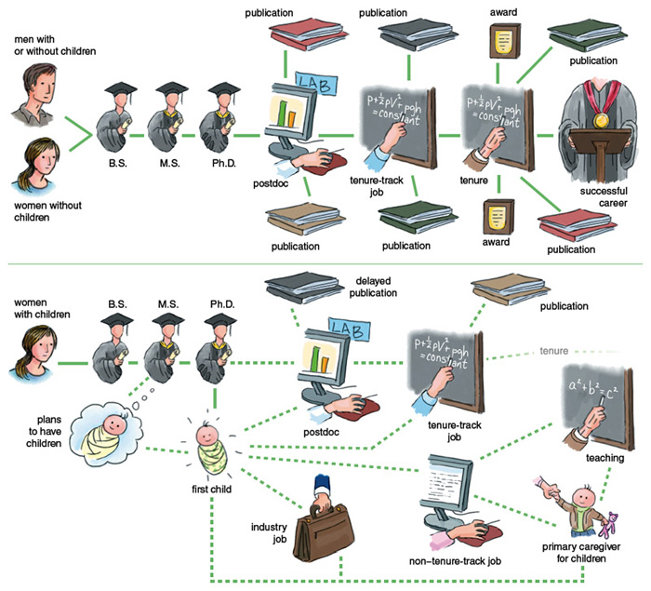

Slide 14
Even if women split childcare duties evenly with a supportive partner they are still competing with many men who do much less at home.
Found that the number of male preprint authors (in science) growing faster than the number of female preprint authors
Women are not advancing their research as fast as men during the pandemic
“Men embrace gender equality but still don’t vacuum”
“For now, I will just try my best to climb back up on that ball, and see how much I can juggle. I will remember to count my many blessings, because a few less papers is nothing compared to the lives and livelihoods lost because of COVID-19. But a part of me will always wonder what discoveries women scientists might have made were it not for this pandemic and the setback it is causing to the hard-won progress of women in STEM.”

Slide 15
Don’t be too hard on yourself! I’ve tried to allocate tasks to each day and taken a day by day approach rather than stressing about how many hours I’ve managed to work in a day
“Communicate with your husband - highlight your frustrations and suggest ways to level the playing field to ultimately strengthen the relationship between the two of you and your family. Males and females operate differently (significantly so), so be clear in your discussions (no level of hinting will be effective).” Amber

