Slide 1
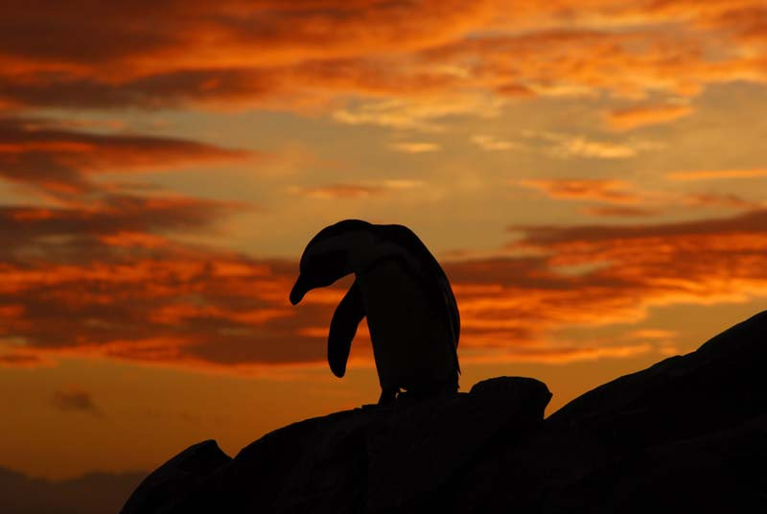


Ecological Grief
and the burden placed on women
Adj. Prof. Lorien Pichegru

Slide 2

Notes:
1- Describing the emotional toll of ecological loss.
Being biologists during the Holocene extinction can be extremely challenging. As scientists, we are at the forefront of receiving evidence of global environmental destruction. We are observing first-hand the greatest, most rapid environmental changes than ever previously witnessed by humans, while also having the most profound knowledge than ever before. Many of us have witnessed during our individual careers, our study species or ecosystems dwindle or collapse, often engaging in battles to halt such destruction with the scientific tools we have, turning into conservationists, and sometimes activists or politicians.

Slide 3
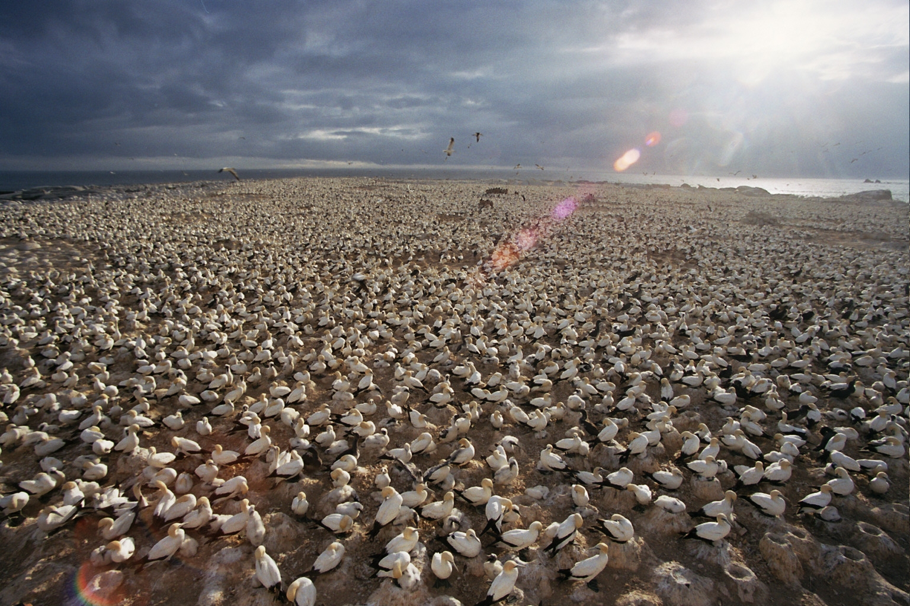
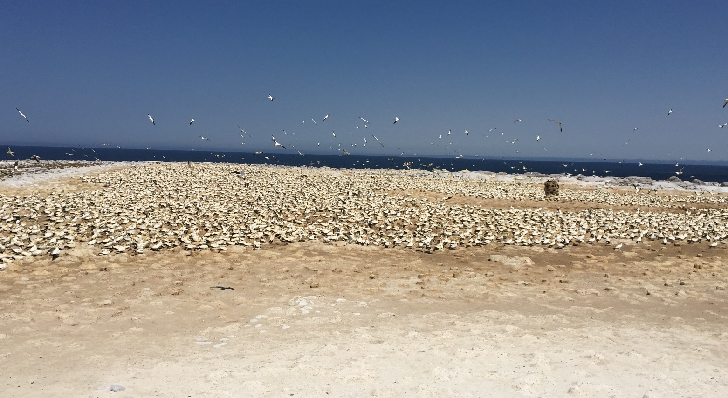
Malgas Island, West Coast 2003 - 2018
2003
2018
Notes:
My own experience:
In 2018: firs time since 2005 I could not work on Cape gannets because the colony was too small
In 2019, the first time I could not work on St Croix because the colony was too small.
Meanwhile in April, Notre Dame 1 billion euros raised within a few weeks…
When a colleague told me the term ecological grief

Slide 4
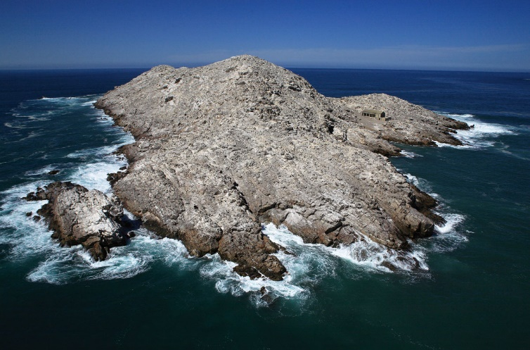
St Croix Island, Algoa Bay 2008 - 2019
Notes:
My own experience:
In 2018: firs time since 2005 I could not work on Cape gannets because the colony was too small
In 2019, the first time I could not work on St Croix because the colony was too small.
Meanwhile in April, Notre Dame 1 billion euros raised within a few weeks…
When a colleague told me the term ecological grief

Slide 5
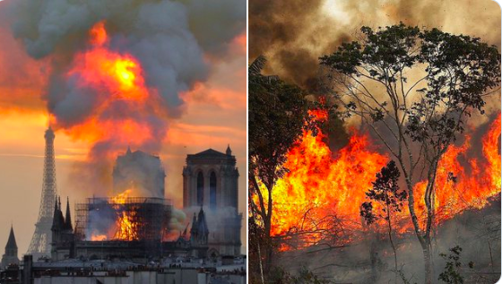
Notes:
My own experience:
Meanwhile in April, Notre Dame 1 billion euros raised within a few weeks…
When a colleague told me the term ecological grief

Slide 6
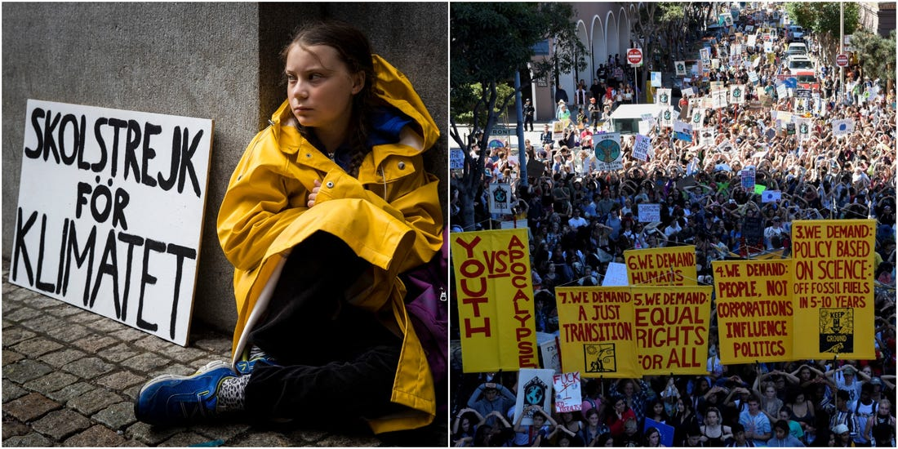
Notes:
In 2019, as climate protests, heatwaves and a barrage of natural disasters have pushed climate up the news agenda, eco-anxiety has exploded across the Western world—even as developing countries have suffered most from climate change so far.

Slide 7
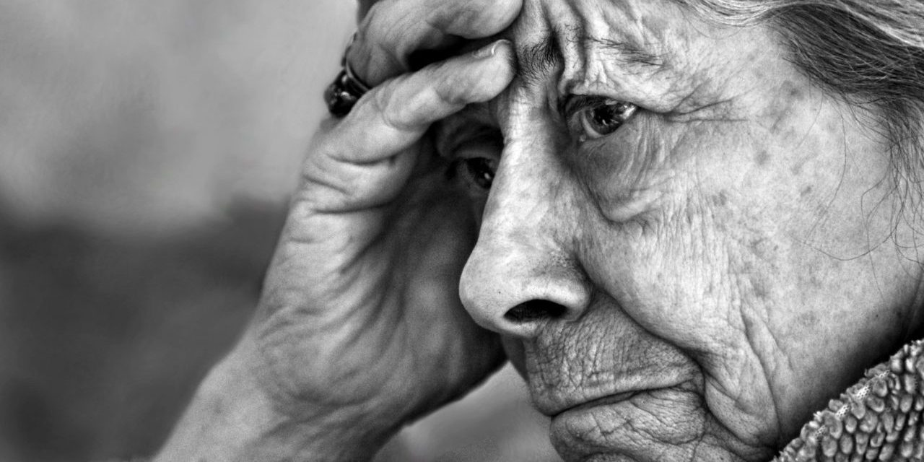
Ecological grief
Cunsolo & Ellis 2018 Nature Climate Change
Notes:
Ecological grief is a recently recognised form of depression, caused by environmental destruction or climate change.
Like other forms of grief, the symptoms are the typical stress response: “fight, flight or freeze”.
Associated emotions can include anxiety and judgement, shock and anger, sadness and shame. Distress might appear as insomnia and restlessness, agitation, stomach aches, disordered eating habits, difficulty concentrating or impulsivity, social isolation or panic attacks.
However, unlike other forms of depression, it is a slow and cumulative grief without an end. Often unacknowledged, it can however be severe and debilitating, giving a feeling of isolation, making us question our very purpose as biologists or scientists.
Seeing the looming catastrophe arriving and the inaction of our governments and the ignorance of many, can make us doubt of the usefulness of our very jobs, wondering if writing papers matter so much, if perhaps we shouldn’t even change career or run away to live in a cabin somewhere int the mountain! So in that sense it can be debilitating, counter-productive for what we should be doing. That powerlessness or even more when feeling desperate can rob us of our will to engage and take action.

Slide 8
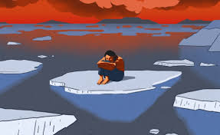
The paradox of the scientists
“Scientists must be allowed to cry”
Gordon et al. 2019 Science 10.1126/science.aaz2422
Notes:
Most importantly, for us scientists, we are at the forefront of ecological grief, however we somehow not allowed to express it.
Earlier this year, I started to the radio about it, there was no interest. A journalist asked me what I was working on , and when I said so, he said “I hope you realise that we the public are hoping that you scientists are working on finding solutions rather than working on grief”…
Eco-grief sits somehow in the category of disenfranchised grief, a grief that isn’t publicly or openly acknowledged, those who express it can be shunned as being fringe extremists, too sensitive or weak.”
Last year, Hoggett and psychotherapist Ro Randall compared how activists and scientists managed their emotions in relation to climate change. “Activists sought out emotional support while taking quite risky action, while climate scientists stayed hyper-rational, they suppressed emotions and were essentially fragmented in silos, so their scientific culture became a socially-organised defence system against anxiety. That had a number of repercussions. Some climate scientists burnt out and left the profession. Some who dealt with the public and press were attacked for causing controversy so they became cautious, perhaps underestimating the dangers of climate change.”
I think that is even more valid for women in science, as we are usually more sensitive to grief than many male counterpart, not because of inherent sensibility, I didn’t think, but because society allows us culturally to be more emotional, more in touch with our emotions, than men, whom are supposed to be strong and not grieving.
But then as scientists, we can loose more of our credibility by showing emotions.
However, this young PhD student wrote that beautiful article in Science in December last year, about fact there is no support for the trauma that environmental scientists go through when facing the degradation of the natural world, and they respond by suppressing the subsequent painful emotions and trauma, which can compromise our ability to think coherently. They were basically saying that “To understand and find solutions for our increasingly damaged natural ecosystems, environmental scientists must be allowed to cry and be supported as they move forward.”
They suggested that academic institutes should follow the example of other institutions with professions often facing traumatic experience, like the military, the health care of disaster management.

Slide 9
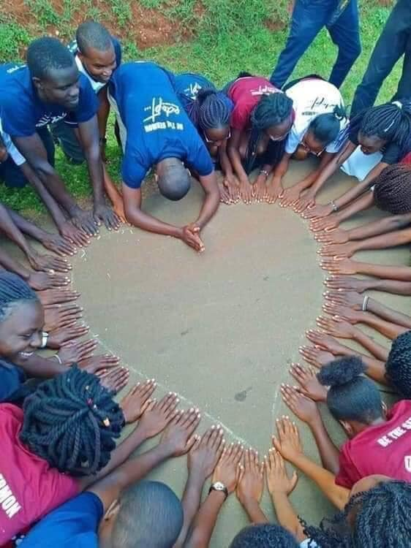
Notes:
So by supporting each other, we should be allowed to grieve well and emerge stronger from traumatic experiences.
We find solace in the words of Parkes and Prigerson who remind us that to grieve is to find strength and maturity, and that ultimately grief might just be the “price we pay for love”.
“In many respects, then, grief can be regarded as an illness. But it can also bring strength. Just as broken bones may end up stronger than unbroken ones, so the experience of grieving can strengthen and bring maturity to those who have previously been protected from misfortune. The pain of grief is just as much a part of life as the joy of love; it is, perhaps, the price we pay for love, the cost of commitment. To ignore this fact, or to pretend it is not so, is to put on emotional blinkers, which leave us unprepared for the losses that will inevitably occur in our lives and unprepared to help others to cope with the losses in theirs.” (p.6 in Parkes and Prigerson22).

Slide 10
https://jembendell.com
Notes:
deep adaptation’, an idea conceived by Jem Bendell, professor of sustainability leadership at the University of Cumbria. Bendell believes that “climate-induced collapse is inevitable and we need to find ways to explore how we are going to cope with that. It’s a tough subject.” His framework hinges on the four R’s (resilience, relinquishment, restoration, reconciliation) and prompts us to ask very different questions about the future, allowing us to let go of what we don’t need, restore what helps life thrive, and become more resilient while preparing for radical change.
On first reading Bendell’s paper on deep adaptation, Spencer felt liberated: “He’s created a new map [to navigate climate tragedy] and deep adaptation is the extreme opposite of denial - it’s a new orientation towards life in the face of ecological catastrophe.” Spencer embraces the fact that we can’t know how to do this – there’s no quick fix to climate collapse. “Most of this we can’t fix, and that’s what deep adaptation is all about – it’s devastating, but we must welcome every response we have, otherwise we’d fall back into denial.”

Slide 11
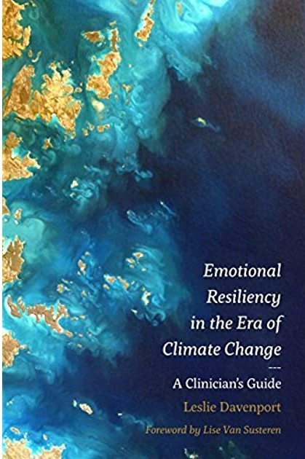
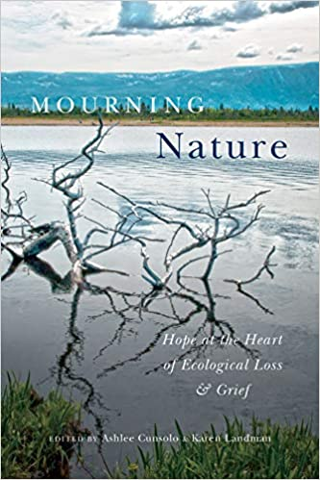
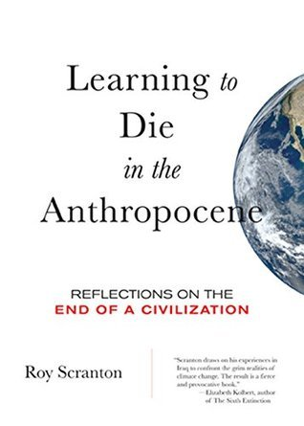
Notes:
Understanding our own mortality and sense of briefness on the planet, hence the impact we will leave on the planet, feeling of being fragile, hence appreciation and immersion in the moment.

Slide 12
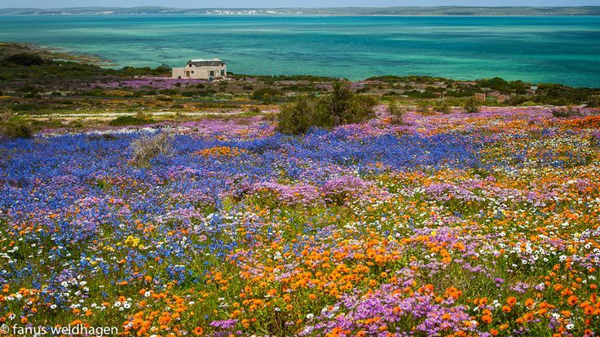
“Mitigation, adaptation and joy –integrate all three into what we do next.”
Limiting our carbon foot-print while reconnecting with nature
Normalising the conversation amongst like-minded people, expressions can take various forms (art, blog, support groups) and be on various platforms
Engaging, being active, both locally and politically; focusing on the positive stories
Notes:
Also focus on the positive stories
Explore ways forward, from the creation of engagement platforms for scientists and the public, to various actions in the form of civil disobedience, engagement with politics or awareness campaigns about environmental loss and its emotional impacts.
Acknowledging, then phases of accepting, embracing, moving through, seeking support, talking about it in a group of like-minded people, and taking action so we are not stuck in the grief. Expression of some sort can hep (talk, blogging, journaling, art etc)
Solutions can also come from expression.

Slide 13
Population Conversation: Facebook Group conversation with women about climate change and family
The Aching Heart Movement Facebook Group associated with Extinction Rebellion, holds regular online ‘grief circles’ (facilitated by experienced grief workers).
Death Cafe movement is an umbrella movement providing support and resources for local face to face community death cafes.
The Positive Deep Adaptation Facebook Group. This one focuses on sharing ideas and information on how to live well after acceptance of likely (or unfolding) societal collapse.
The Human Near Term Extinction Support Group on Facebook. Useful support to people struggling with that possibility in their awareness. There is also a similar group, same topic but mentioning love in the title, and I’m not sure what the difference is.
Climate Psychology Alliance is aimed mainly at the psychotherapy profession, but has some useful resources. In addition, in the UK this group has launched a network of therapists to provide support. For info, email CPAtherapeutics@yahoo.com
https://jembendell.com

