Slide 1
THE PERFECTIONIST CHALLENGE: KNOWING WHEN TO STOP
CARLA DODD
© Joshua Hoehne, Unsplash

Slide 4
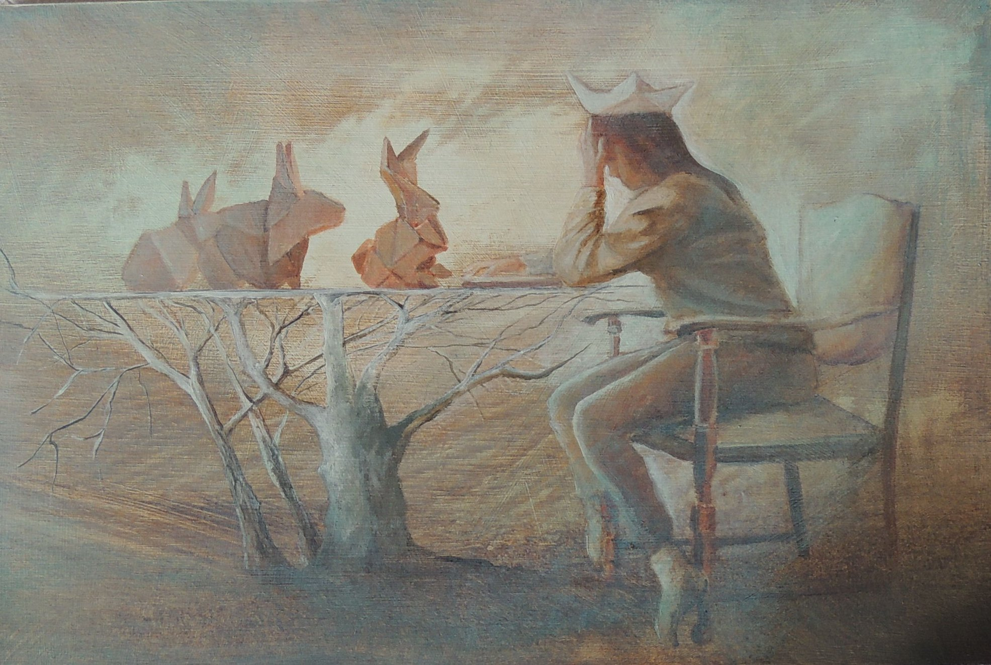

Slide 5
What do we mean by “perfectionist”?

Slide 6
Types of perfectionists
Self-Oriented
Socially Prescribed
Other-Oriented
© Nigel Tadyanehondo, Unsplash
© Nathan Dumlao, Unsplash
© Wesley Tingey, Unsplash

Slide 7
Perfectionism & imposter syndrome

Slide 8
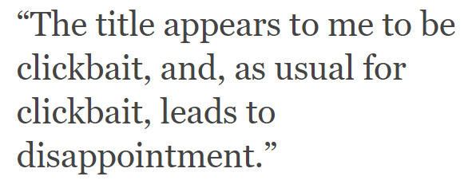

Slide 9
Activation energy – getting started

Slide 10
Overcoming perfectionism – knowing when to stop
© Jonathan Francis, Unsplash

Slide 11
Overcoming perfectionism – knowing when to stop
Pity party stage

Slide 12
“Pointing to where you should be won’t bring you progress or peace.”

